Slide 1
BASICS OF PYTHON
Shakir Sadiq
Python Intern
Drish InfoTech

Slide 2
The presentation is designed to provide Basic knowledge of Python. Python is an easy to learn, powerful programming language. Python’s elegant syntax and dynamic typing, together with its interpreted nature, make it an ideal language for rapid application development in many areas.

Slide 3
Overview
Introduction
Variables
Operators
String & Number
Pylint
Decision Making
Loops
Lists
Dictionary
Tuples
Comprehension
Functions
Modules & Packages
File handling
OS module
Exception handling.

Slide 4
Introduction
High level programming language.
Interpreted and loosely coupled language.
Enriched with built-in and third party libraries.
File Extension - .py or .pyc

Slide 5
Variables
Empty container which hold a value.
No command for declaring a variable.
A variable is created the moment we first assign a value to it.
Variable names are case-sensitive.

Slide 6
Operators
To perform operations on variables and values.
Python divides the operators in the following groups:
Arithmetic operators (+, -, *, /, %, //)
Assignment operators (=, +=, -=, *=, /=, %=)
Comparison operators (>, <, >=, <=, ==, !=)
Logical operators (AND, OR, NOT)
Membership operators (in, not in)
Identity operators (is, is not)
Bitwise operators (>>, <<, &, |, ~, ^)

Slide 7
Strings
Sequence of characters.
Strings are immutable.
Example:
a = "Hello" print(a)
built-in methods:
lower()
upper()
count()
split()
find()

Slide 8
Numbers
There are three numeric types in Python:
int (1)
float (2.8)
complex (1j)
built-in methods:
abs()
len()
sum()
chr()
ord()

Slide 9
Pylint
Pylint is a quality checker for Python programming language
It follows the style recommended by PEP 8.
PEP-8: Python Enhancement Proposal.
Pylint Rating: -10 to +10.
Pylint can be simply installed by running:
pip install pylint

Slide 10
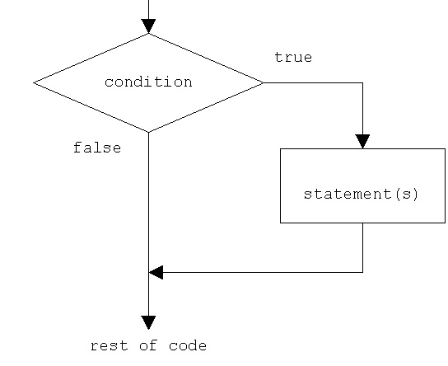
Decision making
Decisions in a program are used when the program has conditional choices to execute a code block.
Python provides various types of conditional statements:
if condition:
“statement”
If condition:
“statement 1”
else:
“statement 2”
If condition1:
“statement 1”
elif condition2:
“statement 2”
else:
“statement 3”
Indentation
(4 spaces or 1 tab)

Slide 11
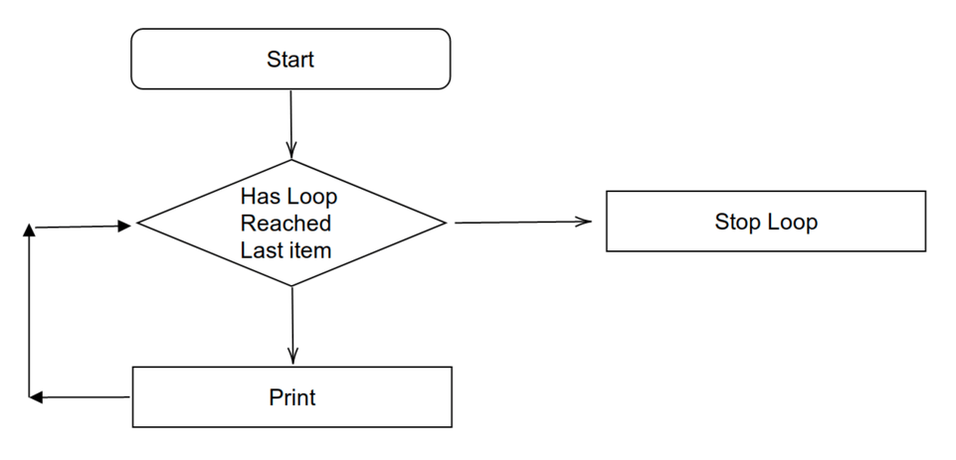
Loops
A for loop is used for iterating over a sequence.
A while loop is used for indefinite iterations.
break and continue statements:
In python break and continue statements can alter the flow of a normal loop.

Slide 12
Lists
Lists are collection of different data types.
Lists are mutable.
Example:
[1,2,’a’,3]
built-in methods:
append()
insert()
remove()
pop()
reverse()
sort()
count()
clear()
len()

Slide 13
Dictionary
Dictionaries are used to store data values in key : value pairs.
Dictionaries are written with curly brackets{}, and have keys and values.
Example:
dict = {‘key1’:‘value1’
‘key2’:‘value2’
‘key3’:[‘v1’, ‘v2’,‘v3’]
‘key4’:‘(‘v5,v4,v6’)}
built-in methods:
update()
pop()
popitem()
clear()
keys()
values()

Slide 14
Tuples
Tuples is the collection of different data types.
Tuples are immutable.
Example:
(1,2,’a’,3,4)
built-in methods:
min() – prints the minimum value in the tuple.
max() – prints the maximum value in the tuple.
len() – length of the tuple.
Comprehension
Comprehension offers a shorter syntax.
List comprehension syntax:
[expression for item in list]

Slide 15
Comprehension
Comprehension offers a shorter syntax.
Comprehension syntax:
(statement1 if condition else statment2)
[i for i in range if condition]
Resultant Loop Condition
[expression for item in list]
[expression for item in list if condition]
{key: value for vars in range}
{key: value for (key, value) in dict if condition}
Decision making
Loops
Lists
Dictionary

Slide 16
Functions
A function is a group of related statements that performs a specific task.
The return statement is used to exit a function and go back to the place from where it was called.
ARGUMENTS:
You can define a function that takes variable number of arguments.
Default Arguments.
Required Arguments.
Keyword Arguments.
Variable Length Arguments.

Slide 17
Lambda Function
A lambda function can take any number of arguments, but can only have one expression.
Syntax:
lambda arguments : expression
Example:
x = lambda a, b : a * b print(x(5, 6))
The power of lambda is better shown when you use them as an anonymous function inside another function.
def myfunc(n):
return lambda a : a * n

Slide 18
Modules & Packages
Modules:
Module is a collection of functions.
We can import a module using the import statement.
import math (or import math as m) import with renaming
import specific names from a module.
from math import pi
import all definitions from a module.
from math import *
dir() function to find out names that are defined inside a module.
dir(math)
Packages:
Packages are the collection of modules.
We can import modules from packages using the dot (.) operator.

Slide 19
Datetime Module
datetime module:
We can import a module named datetime to work with dates as date objects.
import datetime
calendar module:
Python defines an inbuilt module calendar which handles operations related to calendar.
import calendar
Python time module provides several useful functions to handle time-related tasks.
sleep() function suspends execution of the current thread for a given number of seconds.

Slide 20
File Handling
The key function for working with files in Python is the open() function.
The open() function takes two parameters; filename and mode.
“r” – Read, opens a file for reading.
r+ - Opens file for both reading and writing.
rb - Opens file for reading only in binary format.
rb+ - Opens file for both reading and writing in binary format.
“w” – Write, opens a file for writing.
w+ - Opens a file for writing and reading.
wb - Opens file for writing only in binary format.
wb+ - Opens a file for writing and reading in binary mode.
“a” – Append, opens a file for appending.
a+ - Opens a file for both appending and reading.
ab - Opens a file for appending in binary mode.
ab+ - Opens a file for both appending and reading in binary mode.
“x” – Create, creates a specified file.
Different modes

Slide 21
OS Module
File Handling:
Syntax:
file = open(“filename”, “r”) default value.
file.read()
import os
os.getcwd() get current working directory.
os.listdir() list of directories inside.
os.name operating system name.
os.rename() rename a file.
os.remove(“filename”) deletes a file.
os.rmdir(“foldername”) deletes a folder.

Slide 22
Exception Handling
When an error occurs, or exception as we call it, Python will normally stop and generate an error message.
try:
code to execute
except:
handle exception
else:
exception handling for unknown conditions.
Finally:
code meant to execute no matter what.
The raise keyword is used to raise an exception. We can define what kind of error to raise, and text to print to the user.

Slide 23
Thank You!

